Slide 1
About lab today …
You’ll be working with aqueous solutions of salts. An aqueous solution is just a substance (like your salt) dissolved in water. In an aqueous salt solution, the water is called the solvent, and the salt is called the solute.
Turns out, substances often have an impact on the acidity/alkalinity of water when dissolved. This is of vital importance in the oceans*. Some salts make water acidic (making it taste tart), while others make it alkaline (making it taste bitter … but don’t actually taste anything in lab).
Acidity/alkalinity can be evaluated by color using a universal color indicator, and also by a numerical scale called the pH scale (both are shown in the figure at right).
*The pH of water has a huge impact on the health of corals, oysters, plankton, fish, …

Slide 2
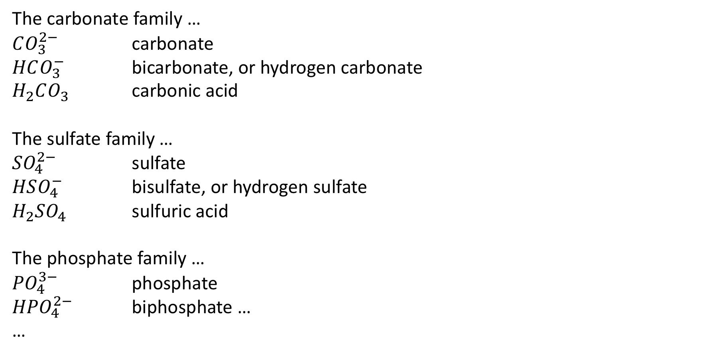
What we’ll be working with this week
The carbonate family …
$CO_{3}^{2−}$ carbonate
$HCO_{3}^{−}$ bicarbonate, or hydrogen carbonate
$H_{2}CO_{3}$ carbonic acid
The sulfate family …
${SO}_{4}^{2−}$ sulfate
$HSO_{4}^{−}$ bisulfate, or hydrogen sulfate
$H_{2}SO_{4}$ sulfuric acid
The phosphate family …
${PO}_{4}^{3−}$ phosphate
${HPO}_{4}^{2−}$ biphosphate …
…
There will also be identification by light!

Slide 3
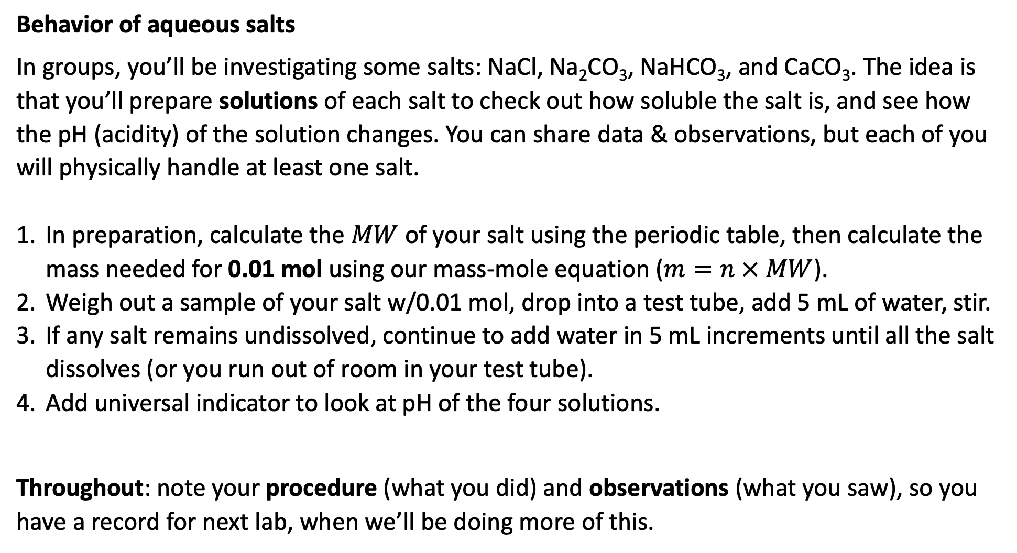
Tasks
Behavior of aqueous salts
In groups, you’ll be investigating some salts: NaCl, Na₂CO₃, NaHCO₃, and CaCO₃. The idea is that you’ll prepare solutions of each salt to check out how soluble the salt is, and see how the pH (acidity) of the solution changes. You can share data & observations, but each of you will physically handle at least one salt.
In preparation, calculate the $MW$ of your salt using the periodic table, then calculate the mass needed for 0.01 mol using our mass-mole equation ($m=n × MW$).
Weigh out a sample of your salt w/0.01 mol, drop into a test tube, add 5 mL of water, stir.
If any salt remains undissolved, continue to add water in 5 mL increments until all the salt dissolves (or you run out of room in your test tube).
Add universal indicator to look at pH of the four solutions.
Throughout: note your procedure (what you did) and observations (what you saw), so you have a record for next lab, when we’ll be doing more of this.

